Slide 1
Digital Logic Families

Slide 2
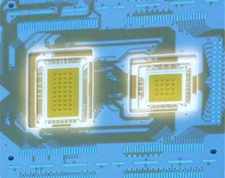
Integration Levels
Gate/transistor ratio is roughly 1/10
SSI
MSI
LSI
VLSI
ULSI
GSI
< 12 gates/chip
< 100 gates/chip
…1K gates/chip
…10K gates/chip
…100K gates/chip
…1Meg gates/chip

Slide 3
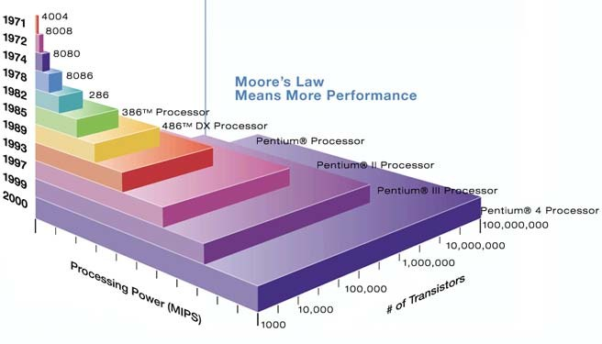
Moore’s law
A prediction made by Moore (a co-founder of Intel) in 1965: “… a number of transistors to double every 2 years.”

Slide 4

Classification
Logic Family
Bipolar Logic Family
ULF(unipolar logic family)
Saturated
Non Saturated
PMOS(p-channel MOSFET) NMOS(n-channel MOSFET) CMOS
RTL(resistor transistor logic)
Schottky TTL
DCTL(direct coupled transistor logic) IIL(integrated injection logic) DTL(diode transistor logic)
HTL(high threshold logic)
TTL(transistor transistor logic)
ECL(emitter coupled logic)
4

Slide 5
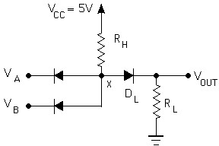

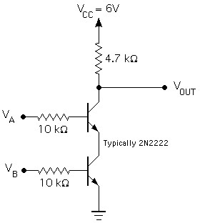

In the beginning…
Diode Logic (DL)
simplest; does not scale
NOT not possible (need an active element)
=
Resistor-Transistor Logic (RTL)
replace diode switch with a transistor switch
can be cascaded
large power draw
=

Slide 6
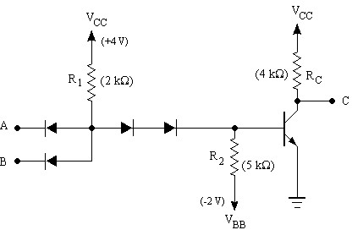
was…
Diode-Transistor Logic (DTL)
essentially diode logic with transistor amplification
reduced power consumption
faster than RTL
=
DL AND gate
Saturating inverter

Slide 7
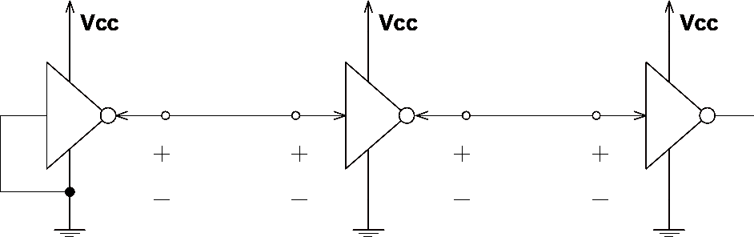
Logic families: V levels
V_{OH}(min) – The minimum voltage level at an output in the logical “1” state under defined load conditions
V_{OL}(max) – The maximum voltage level at an output in the logical “0” state under defined load conditions
V_{IH}(min) – The minimum voltage required at an input to be recognized as “1” logical state
V_{IL}(max) – The maximum voltage required at an input that still will be recognized as “0” logical state
^{V}OH
^{V}IH
^{V}OL
^{V}IL

Slide 8
Logic families: I requirements
I_{OH} – Current flowing into an output in the logical “1” state under specified load conditions
I_{OL} – Current flowing into an output in the logical “0” state under specified load conditions
I_{IH} – Current flowing into an input when a specified HI level is applied to that input
I_{IL} – Current flowing into an input when a specified LO level is applied to that input
^{I}OH
^{I}IH
^{I}OL
^{I}IL
^{V}OH
^{V}IH
^{V}OL
^{V}IL

Slide 9

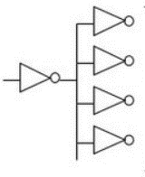
Fan In
Fan in or gate is the number of inputs that can practically be supported
without degrading practically input voltage level.
Fan Out
The maximum number of digital input that the output of a single logic
gate can feed and the gate must be same logic family.
Fan in = 4
Fan Out is calculated from the amount of current available in the output of a gate and the amount of current needed in each input of the connecting gate.
It is specified by manufacturer and is provided in the data sheet.
Exceeding the specified maximum load may cause a malfunction because the circuit will not be able supply the demanded power.
Fanout = 4

Slide 10
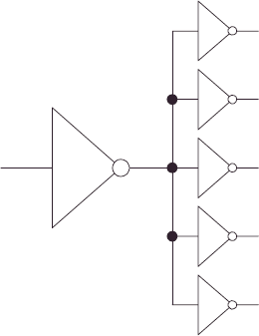
Logic families: fanout
Fanout: the maximum number of logic inputs (of the same logic family) that an output can drive reliably
DC fanout = min( ^{IOH}
, ^{I}OL
)
^{I} IH ^{I} IL

Slide 11
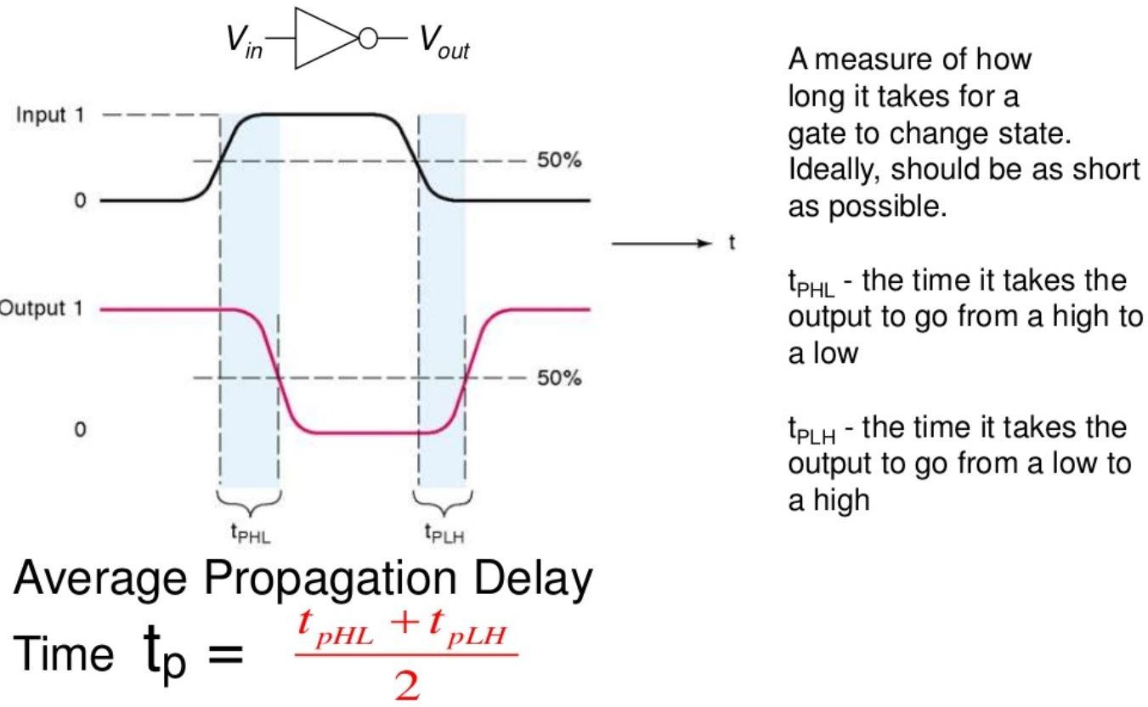
Propagation Delay

Slide 12
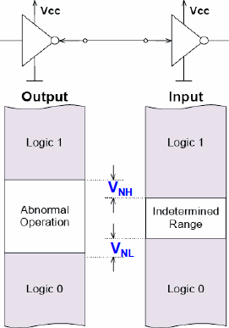
Noise Margin
Noise is present in all real systems. This adds random fluctuations to voltages representing logic levels.
Hence, the voltage ranges defining the logic levels are more tightly constrained at the output of a gate than at the input.
Small amounts of noise will not affect the circuit. The maximum noise voltage that can be tolerated by a circuit is termed its noise immunity (noise Margin).

Slide 13
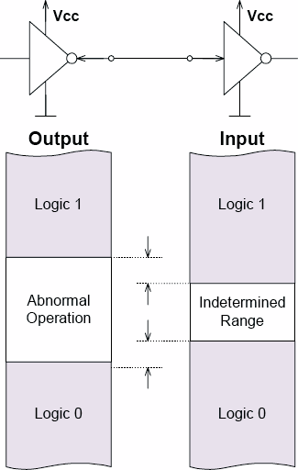
Logic families: noise margin
HI state noise margin:
V_{NH} = V_{OH}(min) – V_{IH}(min)
LO state noise margin:
V_{NL} = V_{IL}(max) – V_{OL}(max)
^{V}NH
Noise margin:
V_{N} = min(V_{NH},V_{NL})
^{V}NL

Slide 14
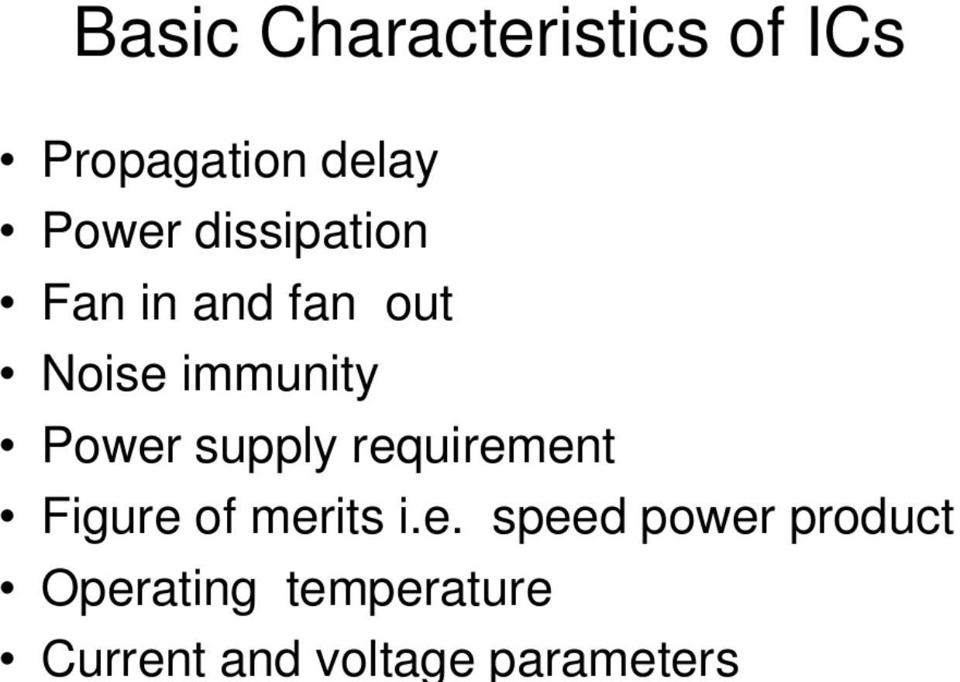
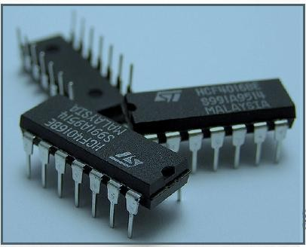

Slide 15
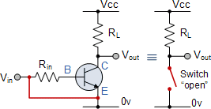
Transistor as a switch
A circuit that can turn on/off current in electrical circuit is referred to a switching circuit and transistor can be employed as an electronic switch.
Cut off region - OFF State
Both junctions are reverse biased, Ic = 0 and V(BE) < 0.7 v
Saturation region - ON State
Ic = maximum and V(BE)>0.7 v

Slide 16
Resistor Transistor Logic(RTL)
The basic RTL device is a NOR gate.
The inputs represent either logic level HIGH (1) or LOW (0).
The logic level LOW is the voltage that drives corresponding transistor in cut-off region, while logic level HIGH drives it into saturation region.
If both the inputs are LOW, then both the transistors are in cut-off i.e. they are turned-off. Thus, voltage Vcc appears at output I.e. HIGH.
If either transistor or both of them are applied HIGH input, the voltage Vcc drops across Rc and output is LOW.

Slide 17
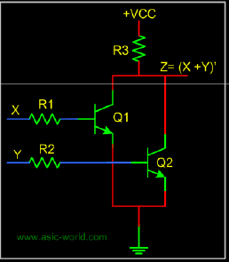
Advantages of RTL Logic circuit:
The primary advantage of RTL technology was that it involved a minimum number of transistors, which was an important consideration before integrated circuit technology, as transistors were the most expensive component to produce
Limitations:
The obvious disadvantage of RTL is its high current dissipation when the transistor conducts to overdrive the output biasing resistor. This requires that more current be supplied to and heat be
removed from RTL circuits. In contrast, TTL circuits minimize both of these requirements.•
(NOR GATE USING RTL)

Slide 18
Diode Transistor Logic
The diode-transistor logic, also termed as DTL, replaced RTL family because of greater fan-out
capability and more noise margin.
DTL circuits mainly consists of diodes and transistors that comprises DTL devices.
The basic DTL device is a NAND gate.
Two inputs to the gate are applied through diodes viz. D1, D2 . The diode will conduct only when corresponding input is LOW.
If any of the diode is conducting i.e. when at least one input is LOW, the voltage at output keeps transistor T in cut-off and subsequently, output of transistor is HIGH. If all inputs are HIGH, all diodes are non-conducting, transistor T is in saturation, and its output is LOW.
.

Slide 19
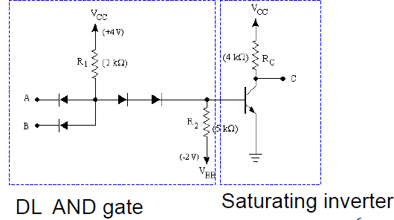

Due to number of diodes
used in this circuit, the speed of the circuit is significantly low. Hence this family of logic gates is modified to
transistor-transistor logic i.e.
D1
TTL family which has been discussed on next slide.
D2
(SATURATING
INVERTER)
(DL AND GATE)
(Block Diagram of DTL)

Slide 20
Transistor Transistor Logic
TTL family is a modification to the DTL. It has come to existence so as to overcome the speed limitations of DTL family. The basic gate of this family is TTL NAND gate.
Q3 is cutoff (act like a high RC ) when output transistor Q4 is saturated and Q3 is saturated (act like a low RC ) when output transistor Q4 is cutoff . Thus one transistor is ON at one time.
The combination of Q3 and Q4 is called TOTEM POLE arrangement.
Q1 is called input transistor, which is multi emitter transistor, that drive transistor Q2 which is used to control Q3 and Q4.
Diode D1 and D2 are used to protect Q1 from unwanted negative voltages and diode D3 ensures when Q4 is ON, Q3 is OFF.

Slide 21
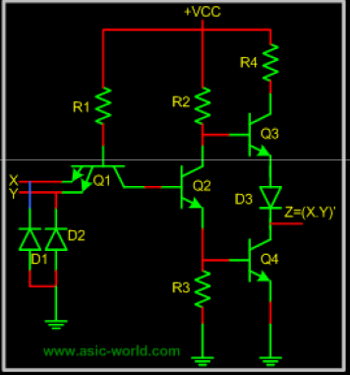
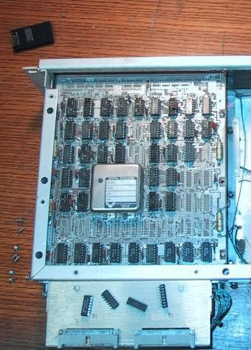
The output impedance is asymmetrical between the high
and low state, making them unsuitable for driving transmission lines. This drawback is usually overcome by buffering the outputs with special line-driver devices where signals need to be sent through cables. ECL, by virtue of its symmetric low-impedance output structure, does not have this drawback.
( BLOCK DIAGRAM OF TTL)
15

Slide 22
Emitter Coupled Logic
ECL logic family implements the gates in differential amplifier configuration in which transistors are never driven in the saturation region thereby improving the speed of circuit to a great extent. The ECL family is fastest of all logic families.
Based on BJT, but removes problems of delay time by preventing the transistors from saturating.
Very fast operation - propagation delays of 1ns or less.
Low noise immunity of about 0.2-0.25 V .
The input impedance is high and the output impedance is low. As a result, the transistors change states quickly, gate delays are low, and the fan out capability is high.

Slide 23
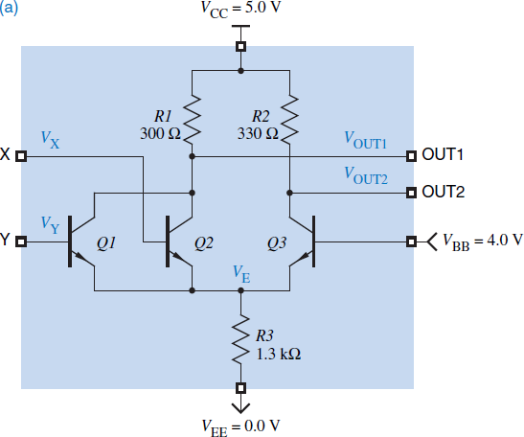
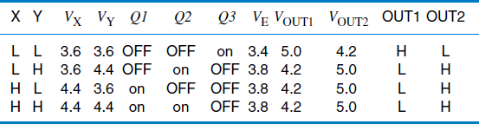
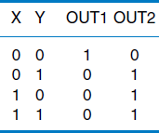

(FUNCTION TABLE)
•
(TRUTH TABLE)
(LOGIC SYMBOL)
(Block Diagram of ECL)
(ECL 2 INPUT OR/NOR GATE)

Slide 24
Complimentary MOS (CMOS)
Considerably lower energy consumption than TTL and ECL, which has made portable electronics possible.
Most widely used family for large-scale devices
Combines high speed with low power consumption
Usually operates from a single supply of 5 – 15 V
Excellent noise immunity of about 30% of supply voltage
Can be connected to a large number of gates (about 50) .

Slide 25
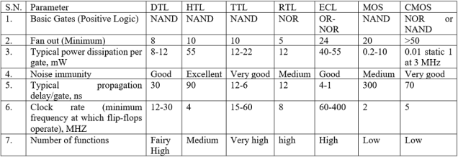
Some statistical characteristics data of different logic families

